Slide 1


ETL Pipeline and Stock Data Analysis
Simon Xie

Slide 2
Investments
$40,000 SPDR S&P 500 ETF TRUST (SPY)
$10,000 Amazon.com Inc (AMZN)
$10,000 Taiwan Semiconductor Mfg. Co. Ltd. (TSM)
$10,000 American Express Company (AXP)
$10,000 Celsius Holdings, Inc (CELH)
$10,000 NVIDIA Corp (NVDA)
Nasdaq-100 (NDX)

Slide 3
Data Cleaning and Transformation
Performed using Pandas and loaded into SQL Server (ETL Pipeline)
Load data through API calls to Polygon
Check for unwanted columns/values and deal with them
Format data to proper standards
Data stored into dataframes for each investment
Aggregated and stored in CSV files

Slide 4
ETL Code Explanation

Slide 5
Visualizations
Loaded data back from database into Python dataframes
Performed using Pandas, Matplotlib, and Seaborn

Slide 6
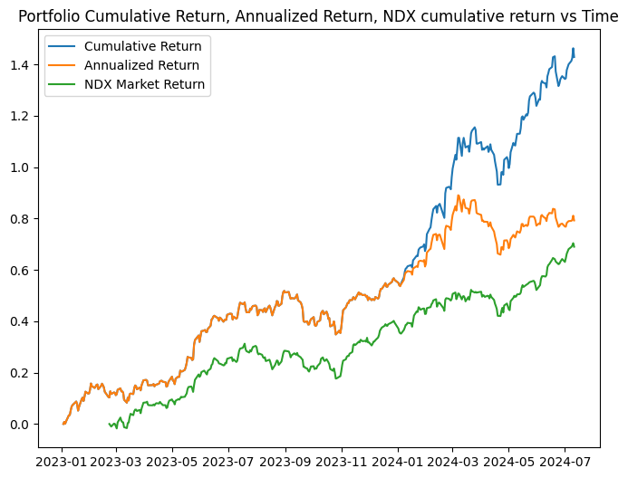
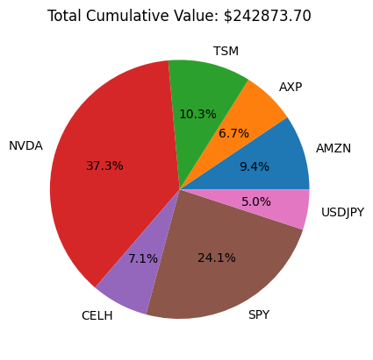
Portfolio Returns

Slide 7
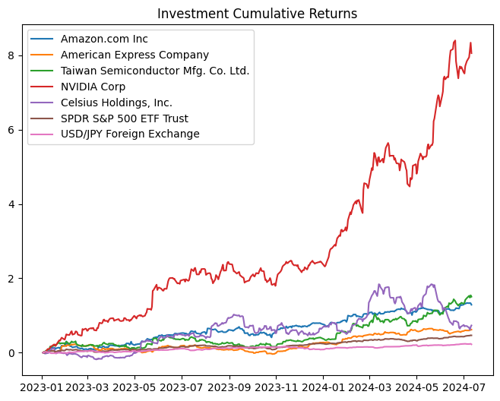
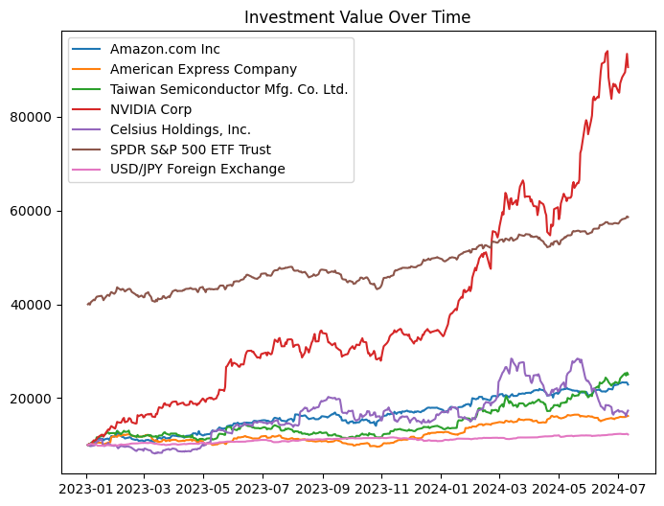
Individual Investments

Slide 8
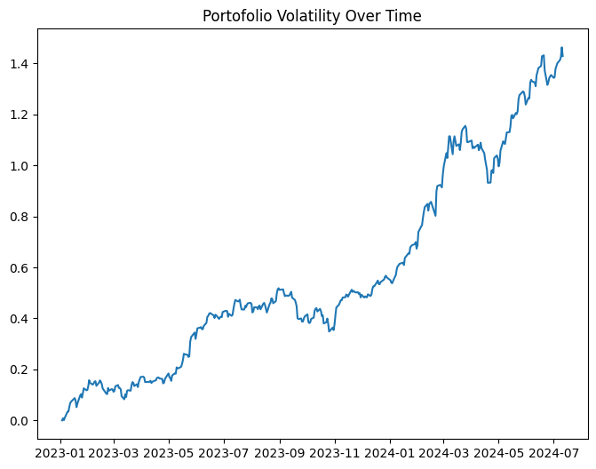
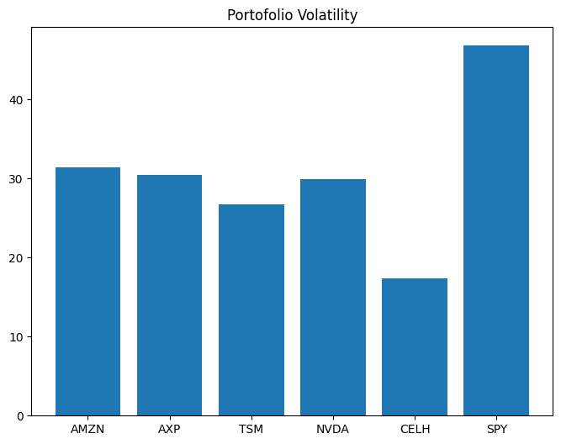
Volatility

Slide 9
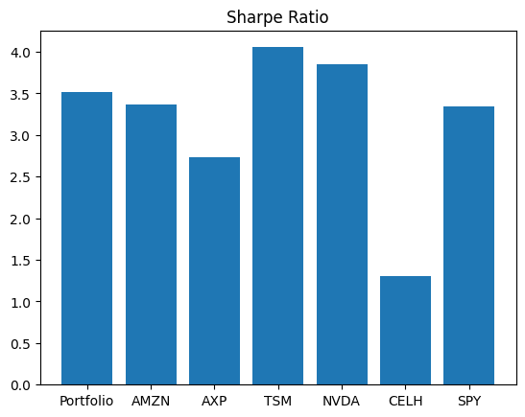
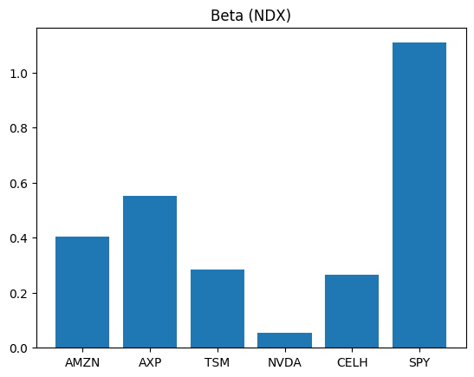
Sharpe Ratio and Beta
Risk-Free value used: US Treasury Bond Yield (5.33%)

Slide 10
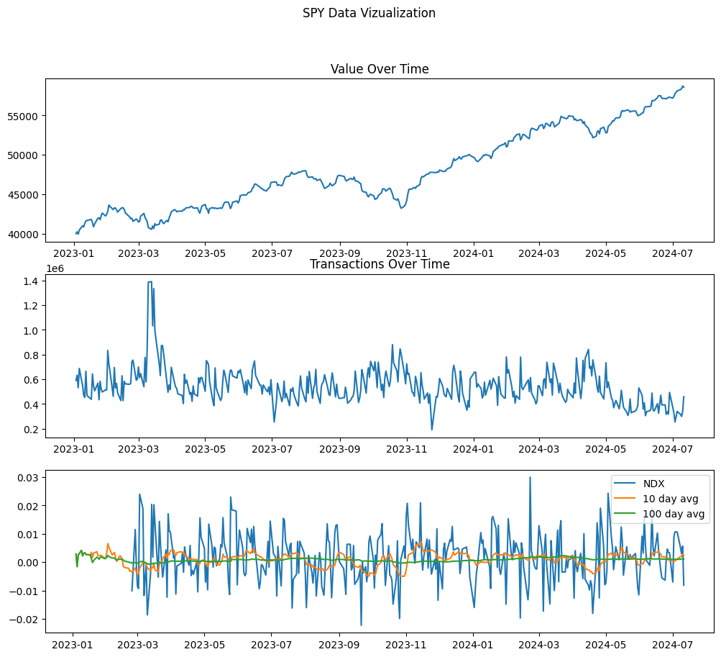
SPDR S&P 500 ETF (SPY)
Total Profit: $18,601.80 (Return of 46.5% at $58,601.80)
Sharpe: 3.34
Beta: 1.11
Volatility: $46.79

Slide 11
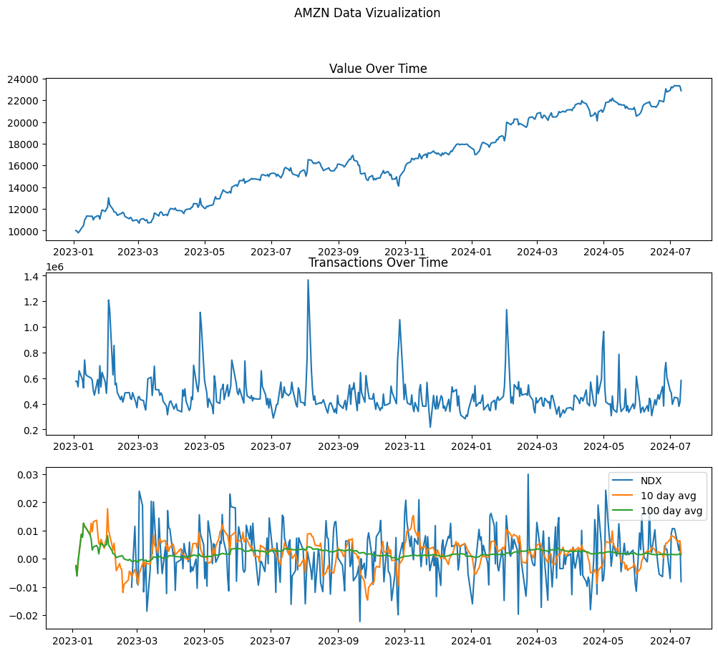
Amazon Inc (AMZN)
Total Profit: $12,883.55 (Return of 128.8% at $22,883.55)
Sharpe: 3.36
Beta: 0.41
Volatility: $31.40

Slide 12
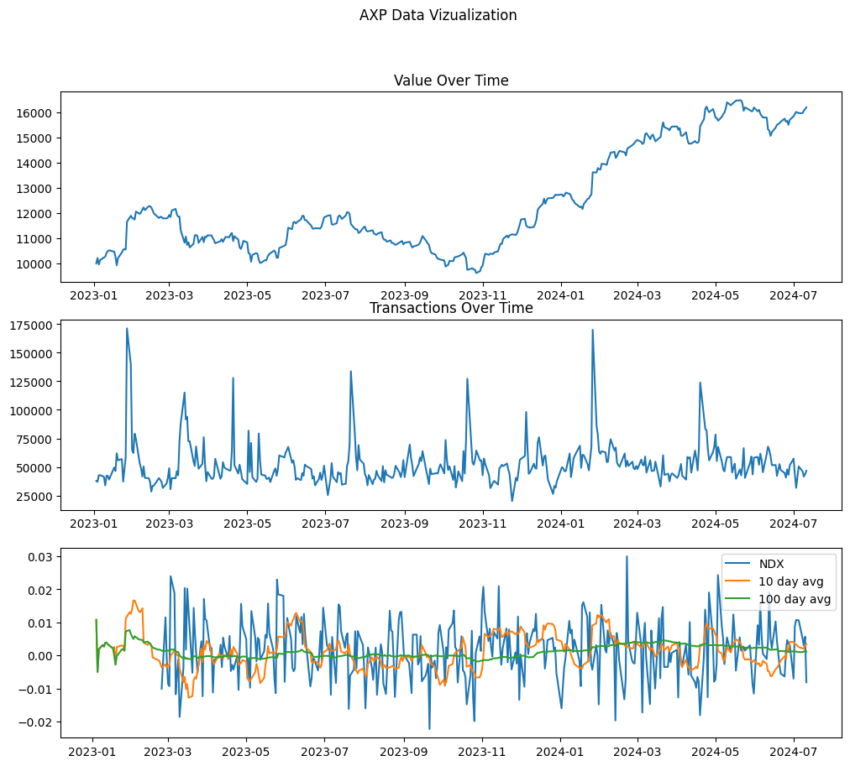
American Express (AXP)
Total Profit: $6,193.55 (Return of 61.9% at $16,193.55)
Sharpe: 2.73
Beta: 0.55
Volatility: $30.45

Slide 13
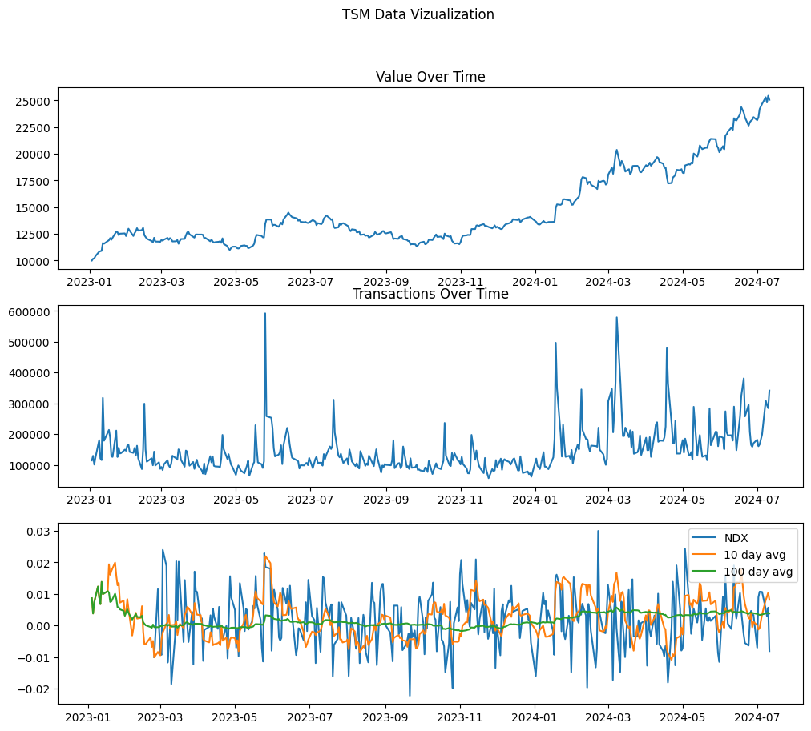
Taiwan Semiconductor (TSM)
Total Profit: $15,059.40 (Return of 150.5% at $25,059.40)
Sharpe: 4.05
Beta: 0.28
Volatility: $26.67

Slide 14
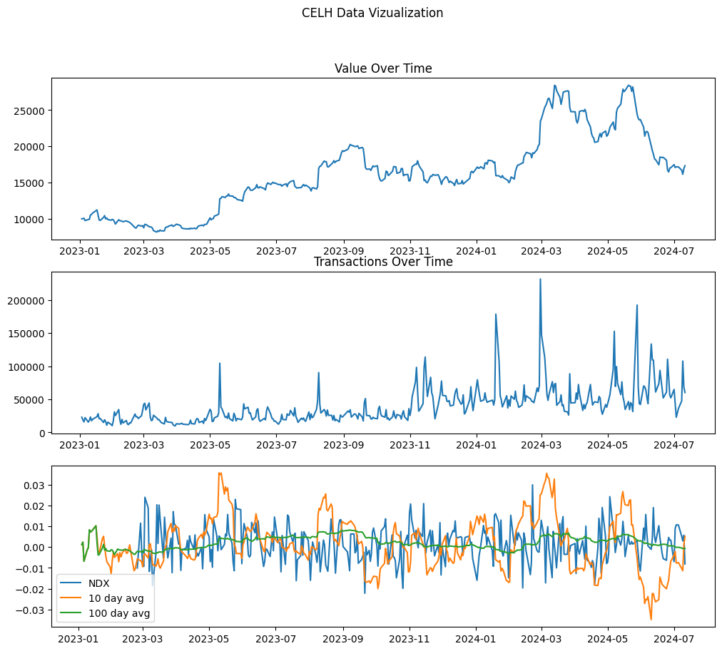
Celsius Holdings (CELH)
Total Profit: $7,327.01 (Return of 73.2% at $17,327.01)
Sharpe: 4.05
Beta: 0.28
Volatility: 26.67

Slide 15
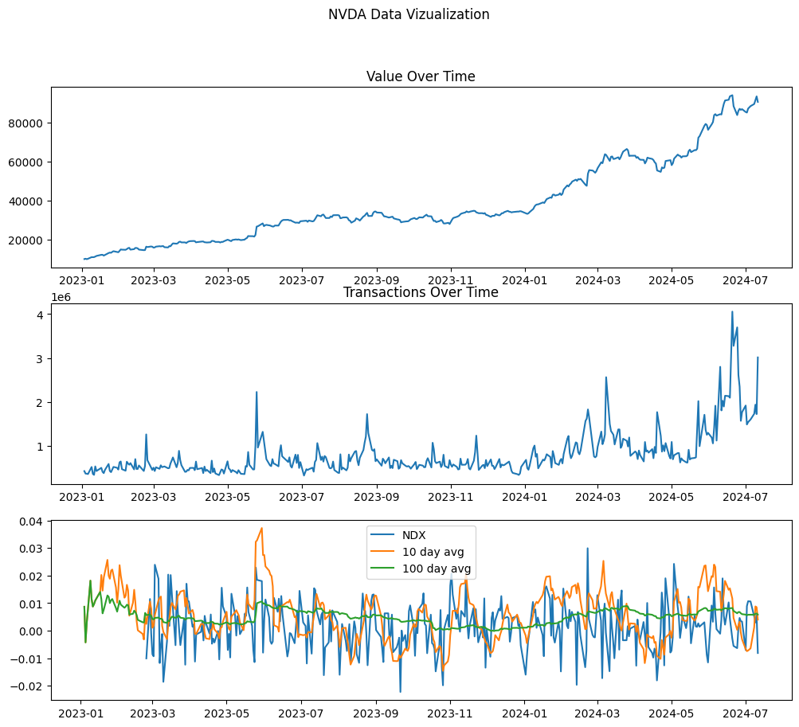
NVIDIA Corp(NVDA)
Total Profit: $80,563.12 (Return of 805.6% at $90,563.12)

Slide 16
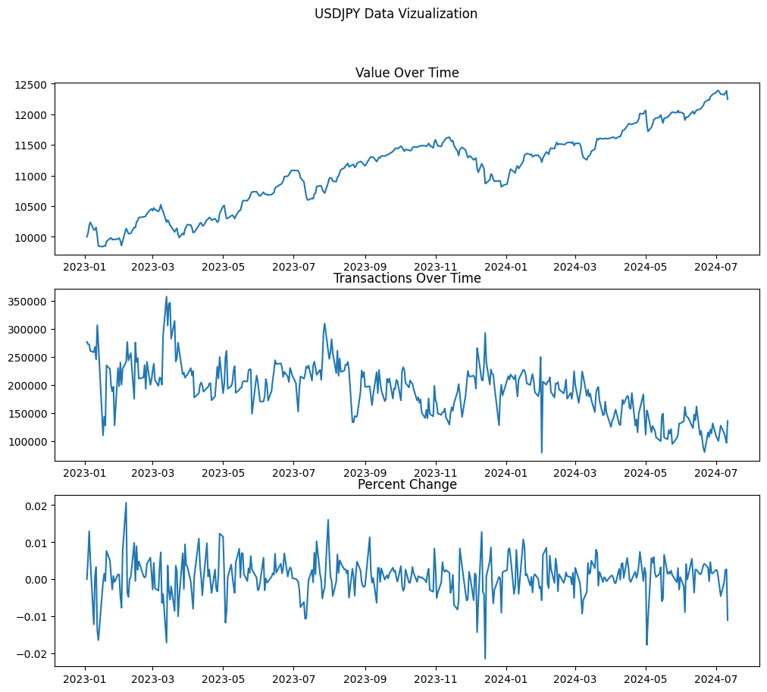
USD:JPY Foreign Exchange
Total Profit: $2,244.96 (Return of 22.4% at $12,244.96)
Losing popularity over time

Slide 17
Key Takeaways
Stocks chosen did not line up with the Nasdaq-100 very well
Would like to explore different sectors of businesses
Questions?

